Slide 1

Public Health Week 7- Demographics in relation to public health practice

Slide 2
Public Health, Module Level 5-(April 2020 intake, LSC London)
Date assignment set | July 2021
Submission deadline task 1 | 1st November 2021
Return date to Students | 29th November 2021

Slide 3

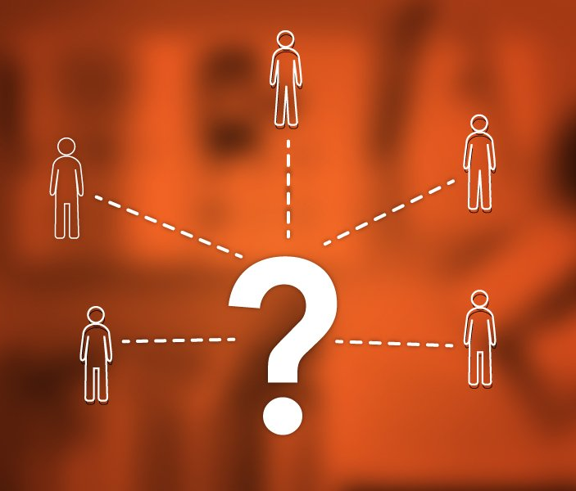
Demographics
https://youtu.be/-rDM3JSsySY
https://youtu.be/P95EmIDSdcI
Demography Introduction

Slide 4

LO3-Analyse the role of epidemiology and demographics in relation to public health practice.
Public Health Week 7

Slide 5
Starter Activity
Individually, (5 minutes)
Using the internet device, research the meaning of demographics.
Learners feedback to the class

Slide 6
https://youtu.be/pCuW6FUBIEA
The population in Europe is continuously changing. People are living longer, having few children, and more people are moving to Europe.
All of these changes contribute to demographic change.
It is important, particularly for younger generations, to learn about demography and how it affects their lives.

Slide 7
Which is the best description of demographics?
Demographics is defined as statistical data about the characteristics of a population, such as the age, gender and income of the people within the population. When the census assembles data about people's ages and genders, this is an example of assembling information about demographics.
Why are demographics important in healthcare?
If patient demographics are properly collected, providers can correctly set up the whole healthcare system with the resources it needs. Demographics can help know what certain groups need attention and the most help. It also helps providers personalize interactions and conversations with patients.

Slide 8

Demographics in relation to public health practice.

Slide 9
https://youtu.be/P95EmIDSdcI
Using the above video link,
Identify the demographic segmentation and the importance of demography
Feedback to the class

Slide 10
What is concept of demography?
“Demography is the study of the size, territorial distribution, and composition of population, changes therein, and the components of such changes, which may be identified as natality, mortality, territorial movement (migration), and social mobility (change of status).”

Slide 11
Demography is the statistical study of populations. It can analyse any kind of dynamic living population, i.e., one that changes over time or space (see population dynamics).
Demography encompasses the study of the size, structure, and distribution of these populations, and spatial and/or temporal changes in them in response to birth, migration, ageing, and death.

Slide 12
What are demographics example?
Demographic information examples include: age, race, ethnicity, gender, marital status, income, education, and employment. You can easily and effectively collect these types of information with survey questions. ... That means you can split a larger group into subgroups based on, say, income or education level.
How does demographic affect healthcare?
The aging of the population affects the demand for all health care services, including hospitals, and long-term care. Older persons use more health services than their younger counterparts because they have more health problems. They are also hospitalized more often and have longer lengths of stay than younger persons.

Slide 13
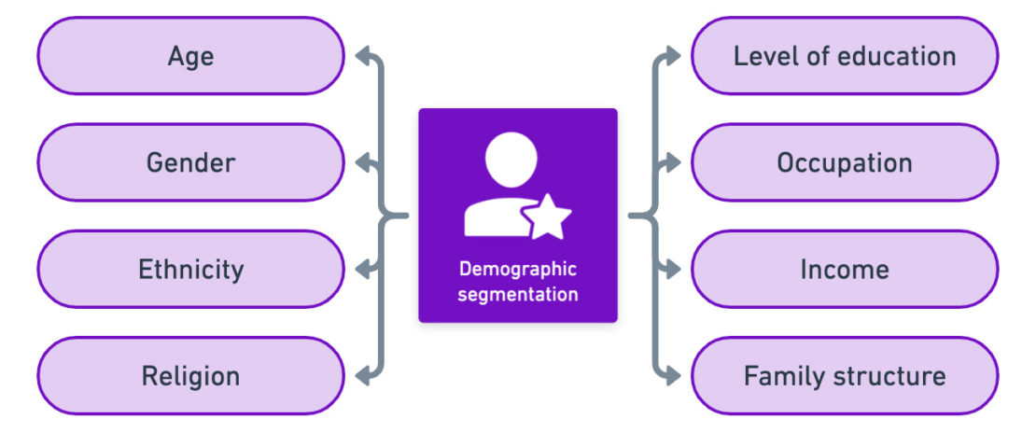
Short break

Slide 14
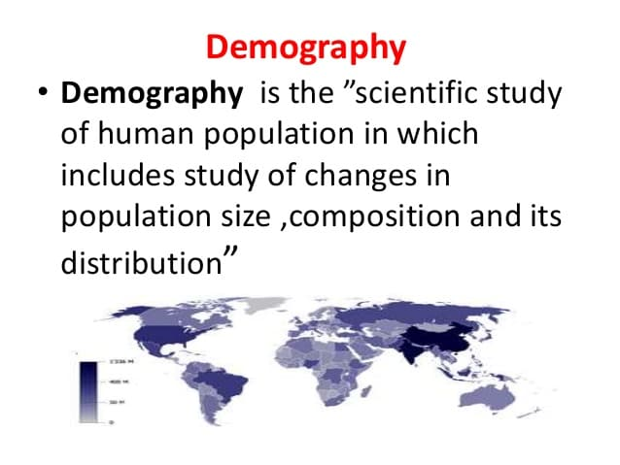

Slide 15
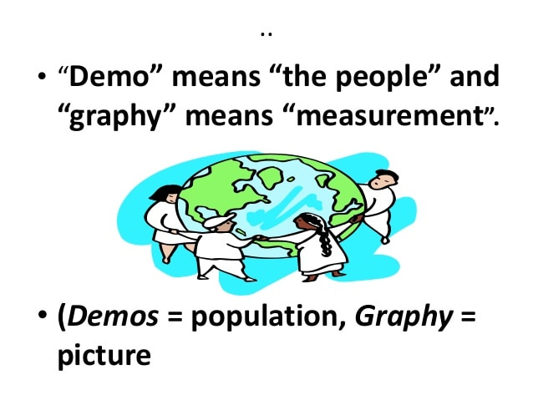

Slide 16
Why is demography important in health and social care?
Demographers have been crucial in the first stage, since population changes are a key component of changing health needs.
Demographic analysis looks at behavioural changes in the population and how these might change a population's structure (age) and composition (gender, race, and so on) in the medium and long term.

Slide 17
How are demography used in public health promotion?
Demographers tend to use surveys and longitudinal study data to examine the relationships between health and population characteristics and the consequences for various population groups.
The projection techniques are widely used for policy and service planning and estimating health needs

Slide 18
What is the relationship between health and demography?
The health and health care needs of a population cannot be measured or met without knowledge of its size and characteristics.
Demography is concerned with this and with understanding population dynamics - how populations change in response to the interplay between fertility, mortality and migration.

Slide 19
This understanding is a pre-requisite for making the forecasts about future population size and structure which should underpin health care planning. Such analyses necessitate a review of the past.
The number of very old people in a population, for example, depends on the number of births eight or nine decades earlier and risks of death at successive ages throughout the intervening period.

Slide 20
The proportion of very old people depends partly on this numerator but more importantly on the denominator, the size of the population as a whole.
The number of births in a population depends on current patterns of family building, and also on the number of women 'at risk' of reproduction - itself a function of past trends in fertility and mortality.
Similarly, the number and causes of deaths are strongly influenced by age structure.
Demography is largely concerned with answering questions about how populations change and their measurement.
The broader field of population studies embraces questions of why these changes occur, and with what consequences.

Slide 21
Data
Due to the scale and threat of the coronavirus pandemic, testing centers, and healthcare systems are required to report all related data, providing epidemiologists with a wealth of information upon which to base their studies.
With this information, epidemiologists will track data including:
Number of Incidences (how many cases over time?)
Disease Prevalence (how many cases at a specific time?)
Number of Hospitalizations
Number of Cases Resulting in Death

Slide 22
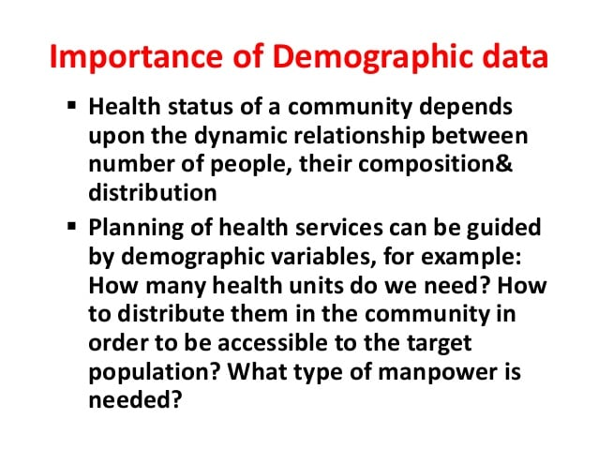

Slide 23
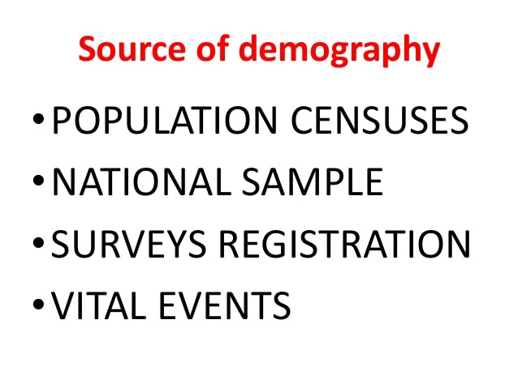

Slide 24
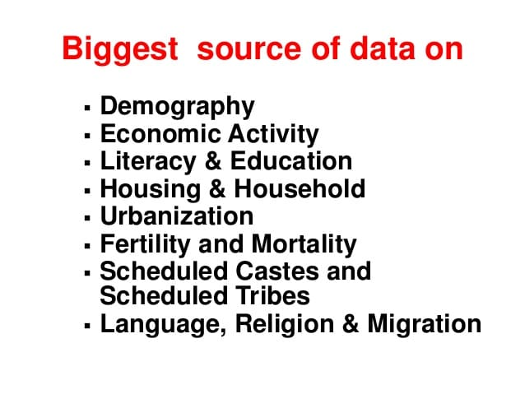

Slide 25
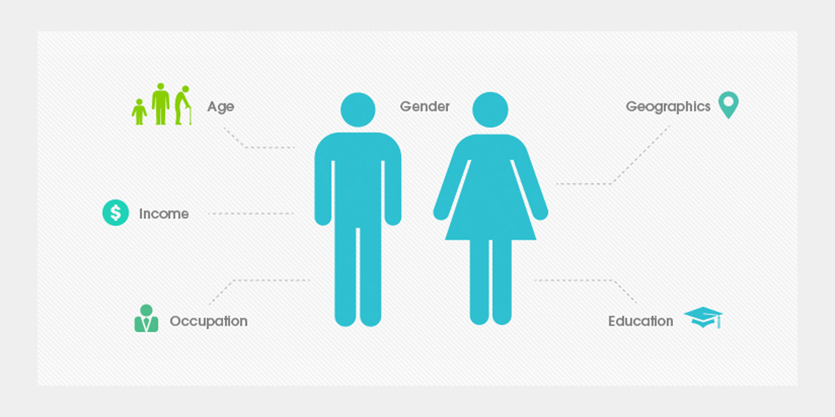
Demographic data
As examples of collections of population level demographic data, we will consider the national census and the General Practice-based Exeter database.
Census data
The most important source of demographic data at the population level for the UK is the ten-yearly census.

Slide 26
Purposes of collecting demographic data
The purposes of collecting patient demographic data and highlights of the important role that front-line registration staff have in collecting complete, high quality information from patients.
“As a front-line hospital admissions/registration staff, you are vital to the patient experience and in helping the hospital better serve patients and the community.
One of the key responsibilities you have is to accurately collect each patient’s personal information, including the patient’s race and ethnicity.

Slide 27
Purposes of collecting demographic data - cont…
Collecting this information is part of the process by which our hospital staff can identify and address unique patient needs.
Patients are more likely to share personal information when asked by respectful, knowledgeable staff, and our hospital is better able to serve its patients when this information is collected for everyone in a consistent manner

Slide 28

Example of a source of demographic data in England
Census as a source of demography

Slide 29
Description
Within the United Kingdom, the national population is determined on the basis of the national census.
Modern censuses have their origins in western Europe.
There are still many countries where there have been no censuses or ones covering only urban populations, or only conducted after several decades.
Countries such as the Netherlands and Germany have population registers, where each person is required to register with the local authority when they move house and these countries have abandoned undertaking censuses.
.

Slide 30
In Great Britain, a census has been carried out every ten years since 1801, except for 1941 It attempts to count all people and households on one day.
The census is overseen by the Office for National Statistics. Before 2001, to administer the census, areas were organised into
Enumeration Districts (EDs) of approximately 200 households.
In 2001, EDs were replaced by Output Areas, which use areas covered by postcodes as the building blocks.
Output areas have approximately 125 households on average, and a minimum of 40.
2011 may be the last UK census, as one proposal is to launch a population register

Slide 31
A census form is delivered to every household and residential establishment in the country.
The forms are completed by members of the household, officially by the 'head' of the household, referring to the specified date of the census, and returned by post.
Participation is a statutory requirement, and enumerators follow up any households from which no form is returned.

Slide 32
Census form-Contd…
In 2001 the data requested related to normal place of residence; in previous decades data was requested for location on the night of the census.
Face-to-face interviews are carried out with a large sample, over 300,000, of households, to check coverage and estimate under-enumeration (numbers of households and persons missed by the census).

Slide 33
Data collected
Data is collected on individuals and on households.
The exact data set varies from census to census.
Ethnicity data were first collected in 1991, and the ethnic group classifications were changed for the 2001 census.
Areas currently collected include the following.

Slide 34
Areas currently collected include the following
For individuals:
Demography: age, sex, ethnic group, country of birth, religion, marital status, population mobility.
In 2011 the expectation is that nationality will be added.
Health: general health status, limiting long term disability, provision of unpaid care
Social class and occupation: economic activity status, occupation, industry.
From these, socio-economic classifications are developed.
In 2011 the expectation is that income will be added.
Education: level of qualifications achieved.
For households:
Household size and structure
Number of rooms
Type of tenure
Amenities
Lowest floor level access
Access to a car or van
Method of transport to work.

Slide 35
Uses
Resource allocation.
Health, educational, transport and housing planning.
The denominator for health and other population statistics.
Analyses of population trends on a wide range of areas: for example health, illness.
Describing deprivation: Townsend, Jarman and Carstairs deprivation scores are all Census based.
The index of multiple deprivation (IMD2004) assigns a deprivation score to each super output area (SOA) and local authority in England.
SOAs are made up of groups of output areas.
IMD2004 uses Census data to estimate population denominators.
Strengths
It is the most complete source of information about the population because it aims to include everyone.
The results of the census are considered the nearest there can be to a gold standard national population.
Data is collected at one time.

Slide 36
Weaknesses
Expensive (2001 Census cost approximately £250 million[3]).
Criticisms of the Census include a tendency to undercount children, young men, homeless people, and members of the armed forces.
In 1991, it was estimated that 10% of men in their 20s and 8% of people over 85 were missed.
In 2001, most of the criticisms related to possible undercounting of inner city populations.
Only undertaken every 10 years.
Self reporting - accuracy difficult to assess. The elderly tend to overstate their age or round to the nearest five years, divorced men tend to report that they are single.
Ethnicity not added until 2001.
The data can take a long time to be released.
Take care when interpreting results, especially at small area level when the data will not be so robust.

Slide 37

Another example of a source of demographic data in England
Patient information

Slide 38

Which.co.uk
What counts as personal data? - Which?
Which.co.uk
What counts as personal data? - Which?
Another example of a source of demographic data in England
Exeter data

Slide 39
Information that you help collect during the registration process on patient demographic data such as: age, gender, race and ethnicity; becomes a part of the patient’s medical record.
This information helps the care team communicate effectively with patients, as well as understand a patient’s culture, which may affect their health.
By knowing more about the patients that we serve, our hospital will be better able to deliver services.
Because race and ethnicity affect patients’ health and healthcare, it is critical to collect this information. You, our front line staff, play a key role in this process.”

Slide 40
Exeter data
Another example of a source of demographic data in England, is the Exeter database, managed by the National Strategic Tracing Service.
Description
The Exeter database stores information at individual patient level, on patient registration with general practitioners

Slide 41
It contains information on:
NHS Number
Name
Address
Postcode
Sex
Date of birth
Place of birth
GP and GP Practice patient is registered with
PCT of where the patient is registered

Slide 42
Uses
The main purpose of the Exeter system was to pay GPs, on the basis of list capitation.
For tracing people as they move and register with a new GP.
For providing GPs with a register.
Deprivation of registered patients at ward level is also factored in when calculating primary care resource allocation.
For recording national adult cancer screening programmes data.
For understanding local populations and to inform practice based commissioning.

Slide 43
Strengths
Crucial for practice profiling by practice clusters, PCTs and public health observatories.
Postcodes enable determination of local authority of residence.
Local authorities do not have equivalent databases of their residents, and in collaborative work between NHS and LAs, the picture of the population that Exeter makes available can be enormously useful.
Weaknesses
GP lists are inflated on average by 5.7%, due to mobility among young adults and delays in removing list members after death or emigration.
Vulnerable populations such as homeless people, asylum seekers, travellers, and some migrant workers tend not to be registered with GPs so are missing from the Exeter system.
Place of birth, which might be useful in ethnic analyses, is a free text field, and may vary from 'home' to country to detailed address.
This covers factors such as age, sex, migration patterns, ethnicity, marital status in populations and how it influences health.

Slide 44
Other roles of demography:
In an effort to ensure equitable treatment outcomes, physicians should look at a broad range of patients’ personal information, such as race and ethnicity.
The collection of demographic data can help inform treatment plans.
For example, ACE inhibitors (a class of medication used primarily for the treatment of high blood pressure and heart failure) treating hypertension have been proven to be less effective for Africans in the western world than other classes of medication such as calcium channel blockers or thiazide diuretics.

Slide 45
Contd…
Collecting race and ethnicity data can help improve the quality of care for all patients, it helps practices:
Identify and address differences in care for specific populations.
Distinguish which populations do not achieve optimal interventions.
Assess whether the practice is delivering culturally competent care.
Develop additional patient-centered services.

Slide 46

Examples of how Demographics affect Healthcare and Nursing Practice:

Slide 47
The Royal College of Nursing encourages nurses to provide customized, culturally specific care that fits with a patient’s values, beliefs, traditions, practices and lifestyle.
The association promotes diversity awareness, which is defined as “an active, ongoing conscious process in which we recognize similarities and differences within and between various cultural groups.”
Diversity awareness also involves cultural assessment and cultural sharing among healthcare professionals with the overall aim of understanding the complex definition of diversity.

Slide 48
The Royal College of Nursing-cont…
Though those are admittedly a lot of factors to keep in mind, ignoring diversity may lead to unequal nursing care and negative patient outcomes.
Whether it is physical pain or emotional stress, patients could experience adverse physiological symptoms if their cultural needs are not taken into consideration.

Slide 49
Diversity and Multiculturalism-cont
Relevant factors include national origin, religious affiliation, language, gender, sexual orientation, age, disability, socioeconomic status and more. Understanding cultural diversity is becoming a daily responsibility for many nurses.
To meet the needs of culturally diverse patients, nurses and other healthcare providers must become both culturally competent and culturally aware.

Slide 50
Diversity and Multiculturalism
Another critical element involved in patient demographic shifts is diversity.
In today’s healthcare system, the relationship between culture and health is central to delivering quality patient care.
The diversity of the general population is a relevant topic on the minds of many nurses.
Because multiculturalism affects the nature of illness and disease as well as morbidity and mortality, nurses must learn to adapt their practice to various cultural values and beliefs.

Slide 51
Details captured in the Patient Registration / Patient Demographics Entry process
Demographics information
Patient's legal name, age, gender, address, phone numbers
Patient's social security number for identification
Medical Information
Allergies if any
Special requirements (interpreter, assistance for physically disabled people, medications, Ambulance, stretcher access, etc.)

Slide 52
Diversity can be based on:
Birthplace
Citizenship status
Reason for migration
Migration history
Religion
Ethnicity
Race
Language
Kinship and family networks
Educational background and opportunities
Employment skills and opportunities
Lifestyle
Gender
Socioeconomic status
Past discrimination and bias experiences
Health status and health risk
Age

Slide 53
https://www.healthknowledge.org.uk/public-health-textbook/medical-sociology-policy-economics/4a-concepts-health-illness/section2
Branas, C. The future of epidemiology: world class science, real world impact. https://www.mailman.columbia.edu/become-student/departments/epidemiology/who-we-are/message-chair/future-epidemiology-world-class-science-real-world-impact
https://www.bmj.com/about-bmj/resources-readers/publications/epidemiology-uninitiated/1-what-epidemiology
Versus Arthritis. 2021. What is epidemiology and why is it important?. [online] Available at: <https://www.versusarthritis.org/news/2020/may/what-is-epidemiology-and-why-is-it-important/> [Accessed 6 September 2021].
https://www.healthknowledge.org.uk/e-learning/health-information/population-health-practitioners/demographic-data
https://www.healthknowledge.org.uk/e-learning/health-information/population-health-practitioners/demographic-data

Slide 54
A vital event refers to the live birth, death, foetal death, marriage, divorce, adoption, legitimation, recognition of parenthood, annulment of marriage, or legal separation
What are the vital events and their impact on demography?
In simple words, Vital statistics, or vital events or vital records as they are known generally, have become an important resource for demographic data. It explicates statistical events such as births, deaths, marriages, divorces, etc.

